Slide 1
Agents and search
How to interact with the environment and how to take decisions

Slide 2
From: Russell – Norvig «Artificial intelligence» Prentice Hall
The structure of Agents
Solving problems by searching: uninformed (blind) search
Informed search

Slide 3

Intelligent agents

Slide 4
What is an agent?

Slide 5
Ideal rational agent
For each possible percept sequence, an ideal rational agent should do whatever action is expected to maximize its performance measure, on the basis of the evidence provided by the percept sequence and whatever built-in knowledge the agent has.
Performance measure
Agent’s a priori knowledge
Agent’s percept sequence
Actions the agent can really perform

Slide 6
Table driven agent
The table of the logaritms!
If P is the set of possible percepts and T the «lifetime» the lookup table will contain
_{t=1}^{T} P^{t} entries!
Lookup table for chess contains 10¹⁵⁰ entries!

Slide 7
Simple reflex agent
Ignore the percept history:
Σ_{t=1}^{T} P^{t} → P
The environment need to be fully observable

Slide 8
The 8 possible states of a simplified vacuum cleaner
Number of states for n rooms either clean or dirty: 2_{c,d} ^{n} x n

Slide 9
Actions on the state space of the vacuum cleaner
If the vacuum cleaner knows its position and if the room is clean/dirty a simple reflex agent can be implemented
Incomplete information? (sensor broken) → random action to escape the loop

Slide 10
Model-based reflex agent
Keeps track of the part of the world it can’t see now.
Driver: keeps track of the previous information about lights:
allows to understand if the car in front is breaking.
Contains a model of the world: how the world works!

Slide 11
Goal-based and utility-based agents
An agent is more flexible if it knows what it has to achieve. Simple situations can be described in terms of a
goal to be reached. More complex situations need the introduction of a utility function (describing the degree
of happiness) that needs to be maximized. For instance, to modify an agent taxi-driver is simple IF it knows its
goal, i.e. the destination. Moreover it can be useful to include also other parameters as safety, time needed, cost
which enter the utility function.

Slide 12
Learning agents
Performance element: what discussed before
Learning element: responsible for the improvements
Critic: tells how well the agent is doing (must be
fixed, potentially outside of the agent)
Problem generator: suggests actions leading to new
informative experiences.
The learning element can make changes to any of the «knowledge» components of the agent.
Observation of pairs of successive states → learn how the world evolves
Observation of the result of an action → learn «what my actions do»
…

Slide 13
Examples of agents

Slide 16
A little recreation: cannibals and missionaries
No more than 2 people on the boat
Number of cannibals <= number of missionaries on both sides of the river
Hint: list all «legal» states and then connect them with lines describing legal actions

Slide 17
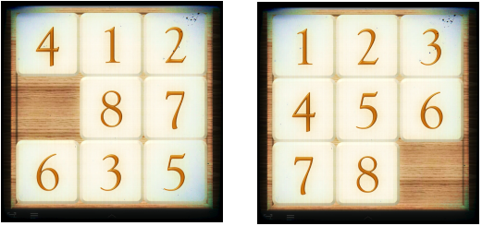
Toy problems: the 8-puzzle and its companions
It is NP-complete
8-puzzle has 9!/2=181440 reachable states
15-puzzle has about 10¹³ states
24-puzzle has about 10²⁵ states

Slide 18
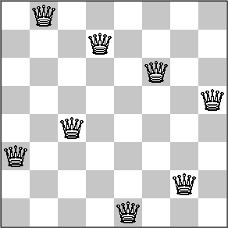
Toy problem: 8-queens
Difficulty depends on the formulation:
Empty board: 64x63x…x57 →10¹⁴ states;
8 queens already on the board all on different
rows and columns: 8!=40320 states
100 queens problem: 100! States, still enormous
But even 1 million queens can be solved by using
a simple (but dedicated) algorithm!

Slide 19
Real-world problems: route finding

Slide 20
Formulation of a problem (we assume a static, fully accessible, discrete and deterministic environment)
Initial state: I am in Timisoara
Possible actions (action, successor): (go Arad, in Arad), (go Lugoj, in Lugoj)
Goal test: in Bucarest?
Path cost from x to y by the action a: c(x,a,y)>=0
Optimal solution: the solution having the lowest cost

Slide 21
Searching for solutions
Check if the inital state is the goal. If not, we expand the current state, creating a search graph.
Definition of node. Five components:
State: one element in state space (n)
Parent-node: the node in the search tree that generated the present node
Action: it was applied to the parent to generate the present node (n-1,a,n)
Path-cost: total cost from the initial state to the node g(n)= Σ_{i=1}^{n} c(i-1, a_{i}, i)
Depth: number of steps from initial state
Fringe: collection of nodes generated but not yet expanded

Slide 22
Parameters characterizing a problem:
b: branching factor or maximum number of successors of any node
d: depth of the shallowest goal node
m: maximum lenght of any path in the state space
Qualifiers of an algorithm searching a solution:
Completeness: does it find a solution if one solution exists?
Optimality: does it find the lowest cost solution?
Time needed: how long to find a solution?
Memory needed: how much memory to perform the search?

Slide 23

Blind search

Slide 24
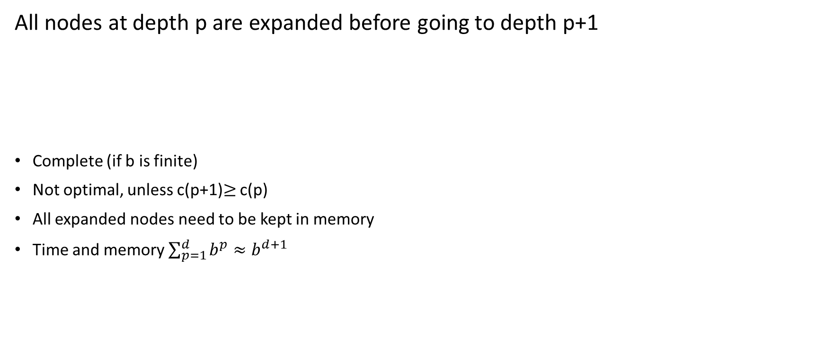
Breadth-first search
All nodes at depth p are expanded before going to depth p+1
Complete (if b is finite)
Not optimal, unless c(p+1)$≥$ c(p)
All expanded nodes need to be kept in memory
Time and memory $\sum_{p=1}^{d}{b^{p}}≈b^{d+1}$

Slide 25
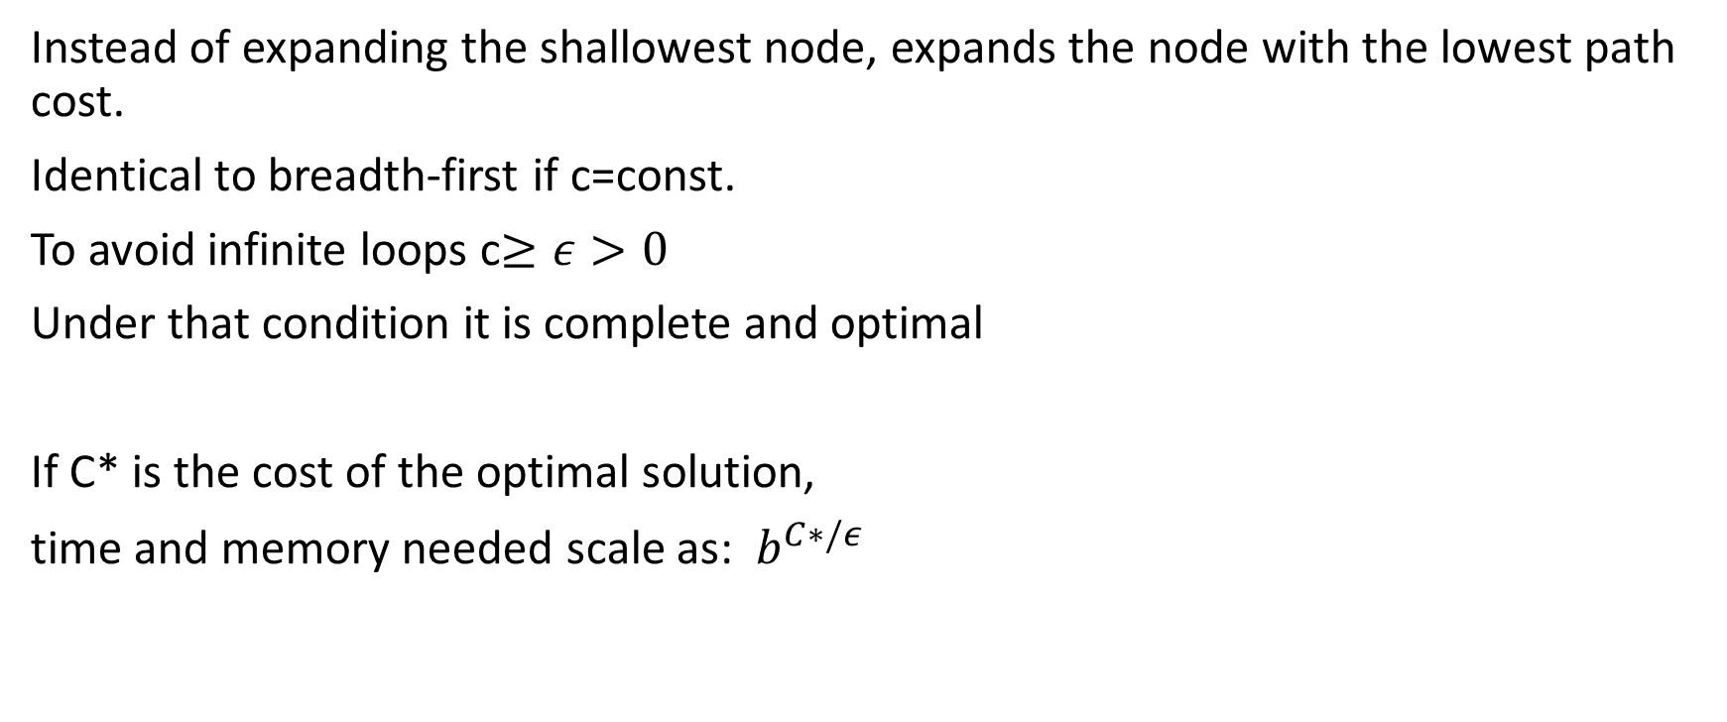
Uniform-cost search
Instead of expanding the shallowest node, expands the node with the lowest path cost.
Identical to breadth-first if c=const.
To avoid infinite loops c$≥ε>0$
Under that condition it is complete and optimal
If C* is the cost of the optimal solution,
time and memory needed scale as: $b^{C∗/ε}$

Slide 26
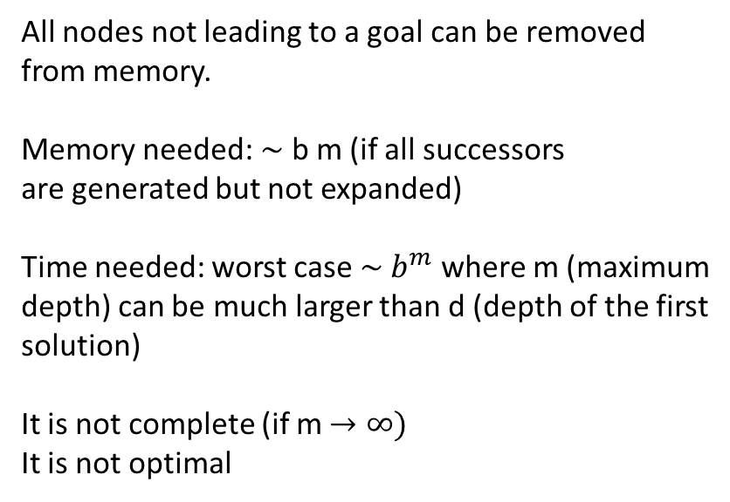
Depth-first search
All nodes not leading to a goal can be removed
from memory.
Memory needed: $\sim$ b m (if all successors
are generated but not expanded)
Time needed: worst case $\sim b^{m}$ where m (maximum
depth) can be much larger than d (depth of the first
solution)
It is not complete (if m $→∞)$
It is not optimal

Slide 27
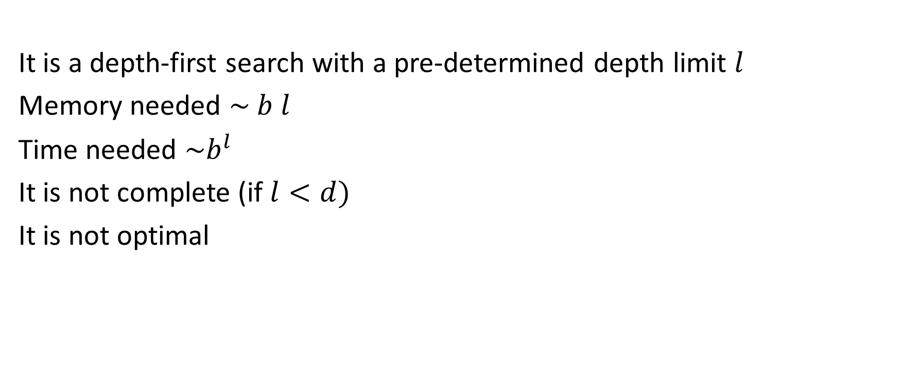
Depth-limited search
It is a depth-first search with a pre-determined depth limit $l$
Memory needed $\sim b l$
Time needed $\sim b^{l}$
It is not complete (if $l<d)$
It is not optimal

Slide 28
Iterative deepening depth-first search

Slide 29
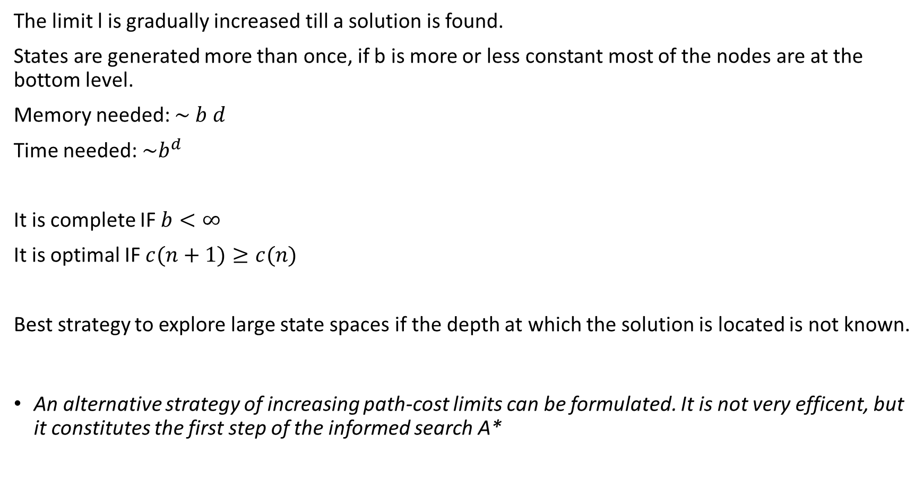
The limit l is gradually increased till a solution is found.
States are generated more than once, if b is more or less constant most of the nodes are at the bottom level.
Memory needed: $\sim b d$
Time needed: $\sim b^{d}$
It is complete IF $b<∞$
It is optimal IF $c(n+1)≥c(n)$
Best strategy to explore large state spaces if the depth at which the solution is located is not known.
An alternative strategy of increasing path-cost limits can be formulated. It is not very efficent, but it constitutes the first step of the informed search A*

Slide 30
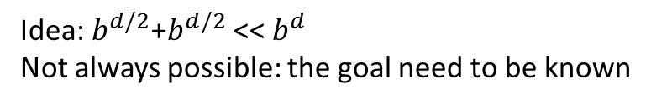
Bidirectional search
Idea: $b^{d/2}$+$b^{d/2}$ << $b^{d}$
Not always possible: the goal need to be known

Slide 31
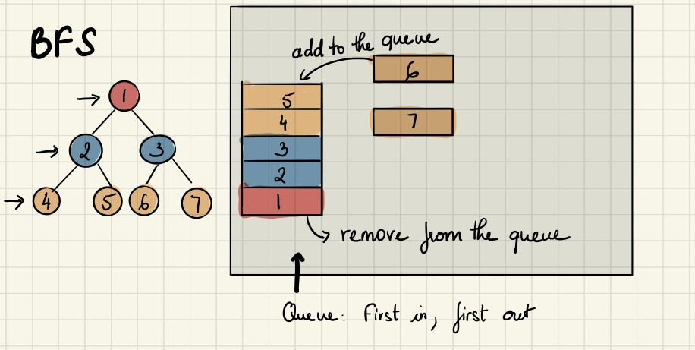
Breadth first
We want to use a data structure that, when queried, gives us the oldest element, based on the order they were inserted. A queue is what we need in this case since it is first-in-first-out(FIFO)

Slide 32
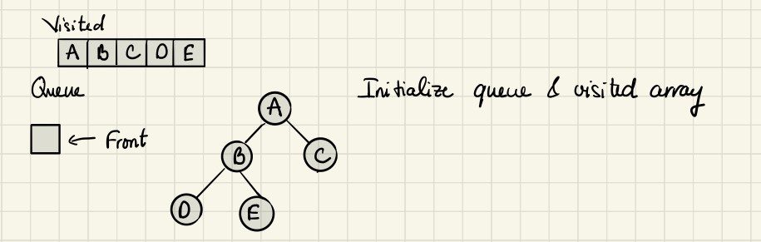
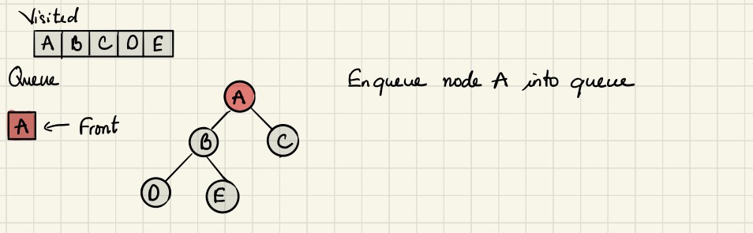
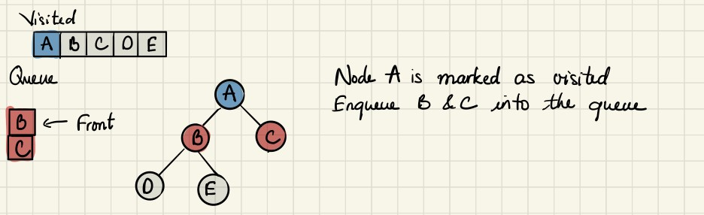
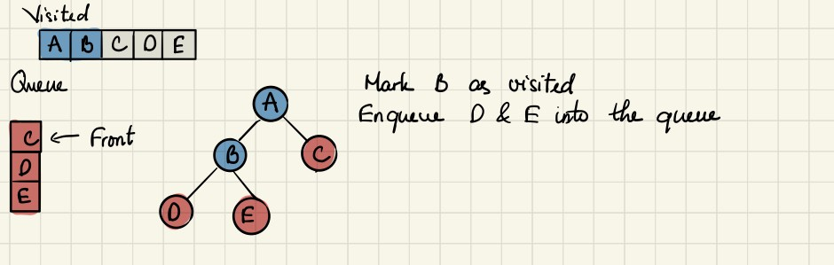
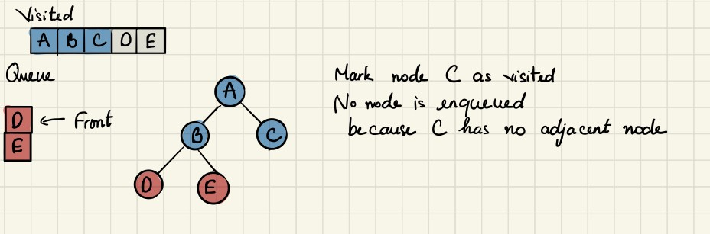
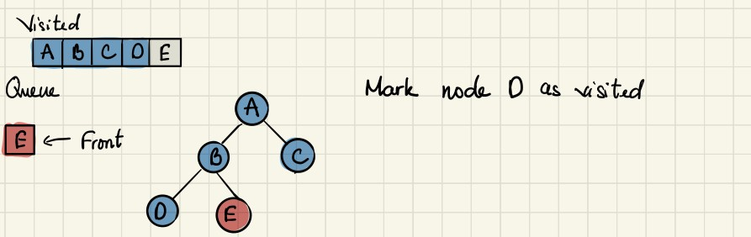
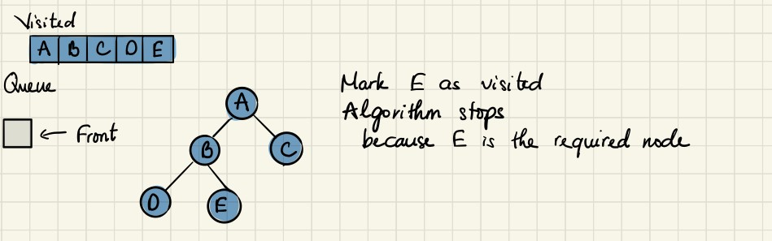
graph = {
'A' : ['B','C'],
'B' : ['D', 'E'],
'C' : [],
'D' : [],
'E' : []
}
visited = []
List to keeps track of visited nodes.
queue is a list that is used to keep track of nodes currently in the queue.
queue = [] #Initialize a queue
def bfs(visited, graph, node):
visited.append(node)
queue.append(node)
while queue:
s = queue.pop(0)
print (s, end = " ")
for neighbor in graph[s]:
if neighbor not in visited:
visited.append(neighbor)
queue.append(neighbor)
pop() is an inbuilt function in Python that removes and returns last value from the list or the given index value
The purpose of “Visited” is to avoid loops, i.e. not to visit twice the same city if it can be reached in more than one way.

Slide 33
pop
list1 = [ 1, 2, 3, 4, 5, 6 ]
# Pops and removes the last
# element from the list
print(list1.pop(), list1)
# Pops and removes the 0th index
# element from the list
print(list1.pop(0), list1)
6 [1, 2, 3, 4, 5]
1 [2, 3, 4, 5]

Slide 34
Depth first
It requires last-in first-out approach, which can be implemented by the “stack”

Slide 35
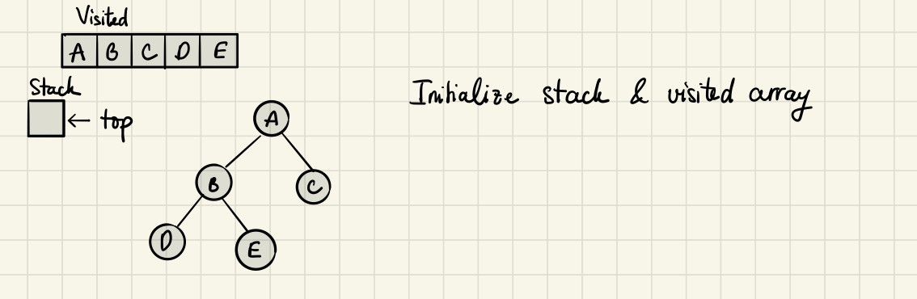
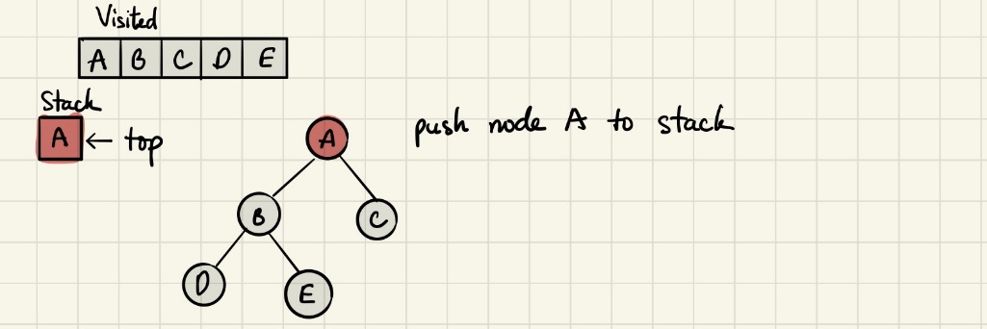
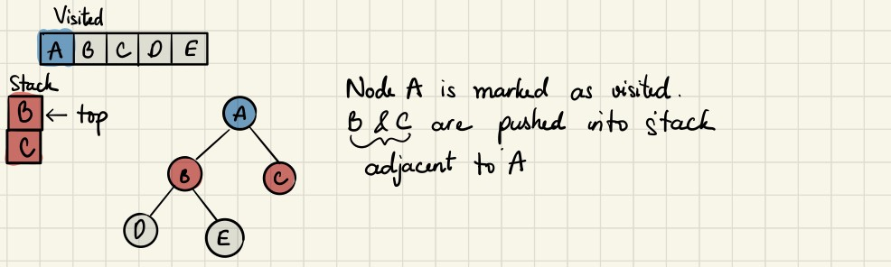
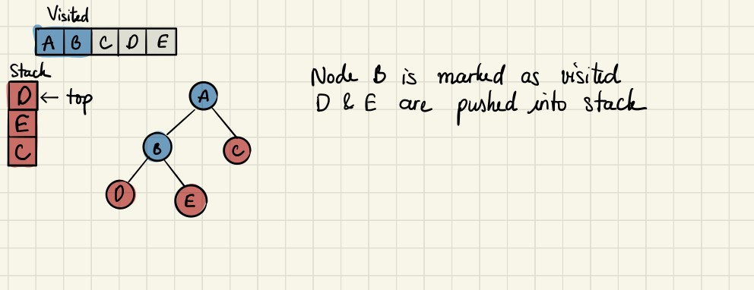
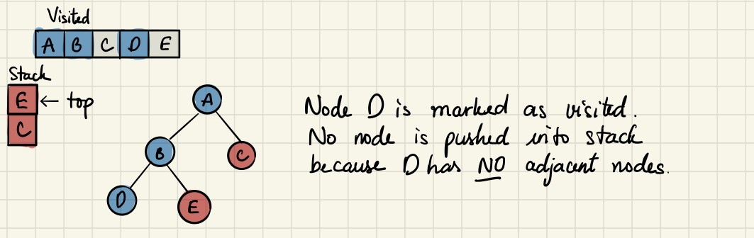
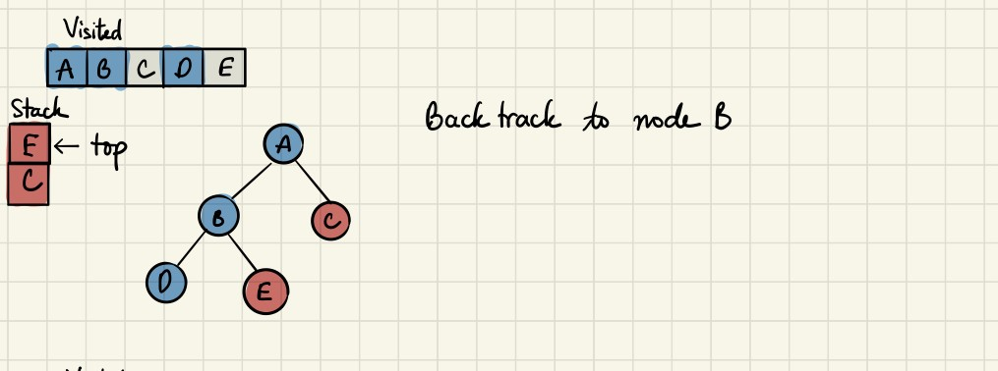
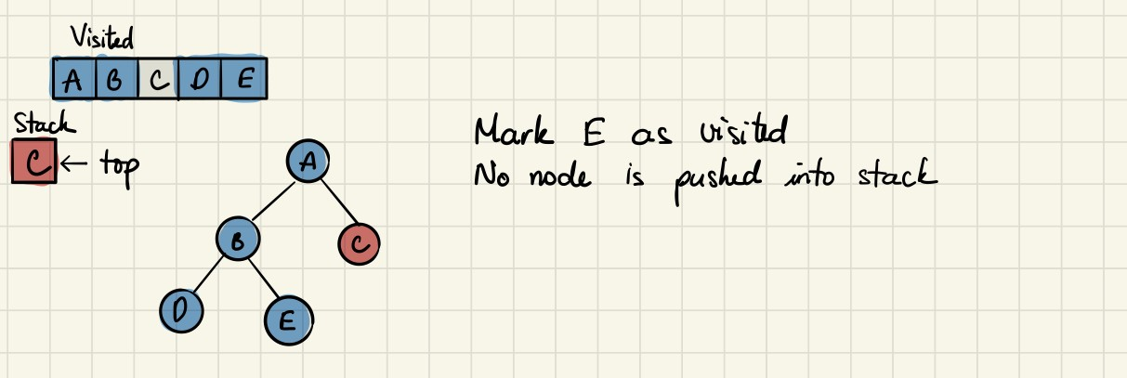
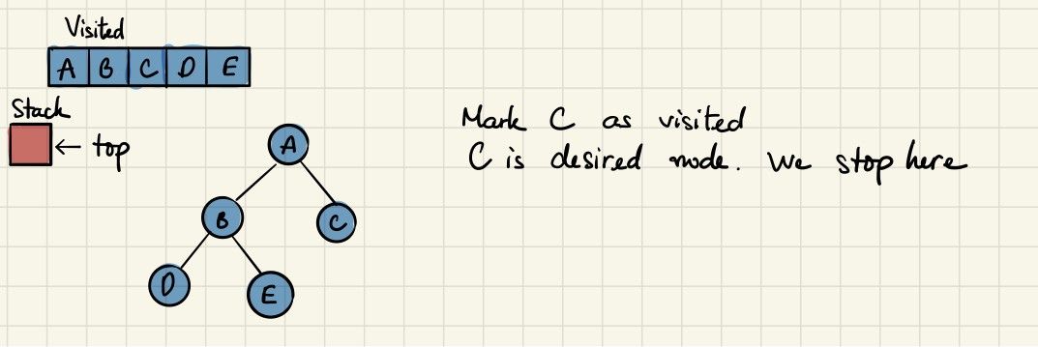

Slide 36

Informed (heuristic) search strategies

Slide 37
Heuristic function
h(n): estimated cost of the cheapest path from node n to the goal
h(goal) = 0
Obviously IF we knew exactly the cost we would have solved the problem!
(we will see later on how to generate good heuristic functions)

Slide 38
Greedy best-first search We expand first nodes having the smallest h(n) down till the end
Similar to depth-first search:
It is not complete (infinite path)
It is not optimal

Slide 39
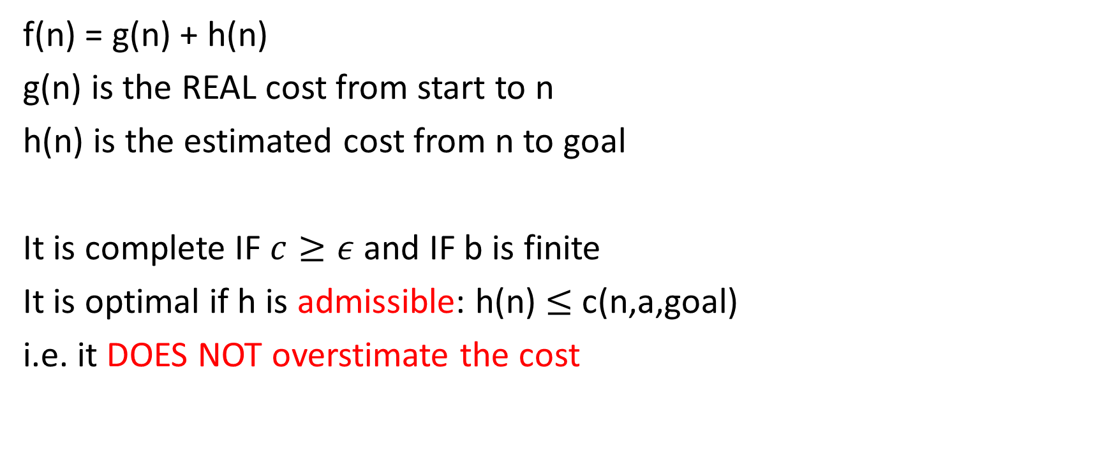
A* search: minimizing the total estimated cost
f(n) = g(n) + h(n)
g(n) is the REAL cost from start to n
h(n) is the estimated cost from n to goal
It is complete IF $c≥ε$ and IF b is finite
It is optimal if h is admissible: h(n) $≤$c(n,a,goal)
i.e. it DOES NOT overstimate the cost

Slide 41
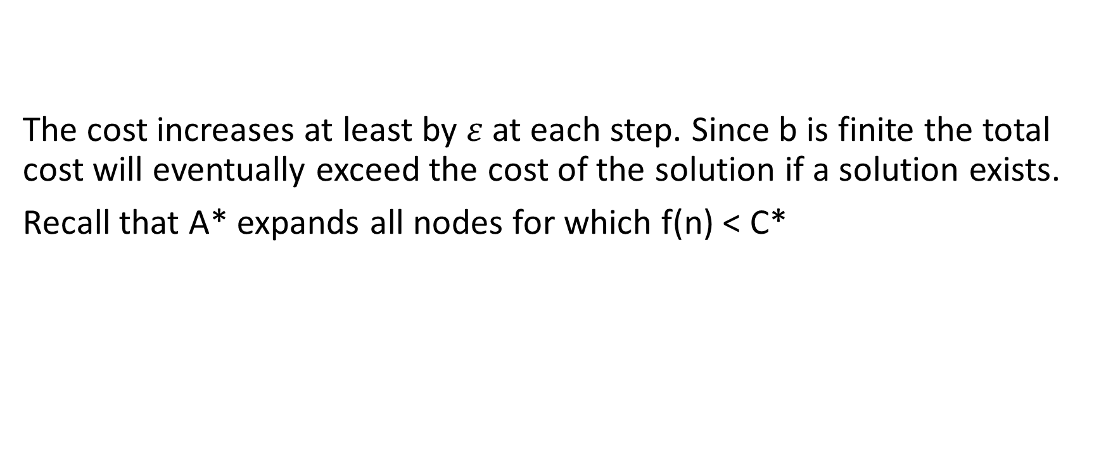

If h is admissible then A* is complete (assuming $c≥ε>0$ and b finite)
The cost increases at least by $ε$ at each step. Since b is finite the total cost will eventually exceed the cost of the solution if a solution exists.
Recall that A* expands all nodes for which f(n) < C*

Slide 42
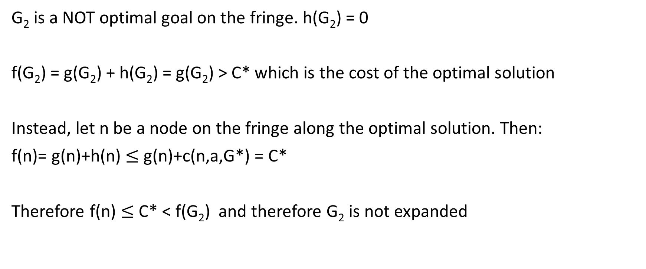
A* is optimal if h is admissible
G₂ is a NOT optimal goal on the fringe. h(G₂) = 0
f(G₂) = g(G₂) + h(G₂) = g(G₂) > C* which is the cost of the optimal solution
Instead, let n be a node on the fringe along the optimal solution. Then:
f(n)= g(n)+h(n) $≤$ g(n)+c(n,a,G*) = C*
Therefore f(n) $≤$ C* < f(G₂) and therefore G₂ is not expanded

Slide 43
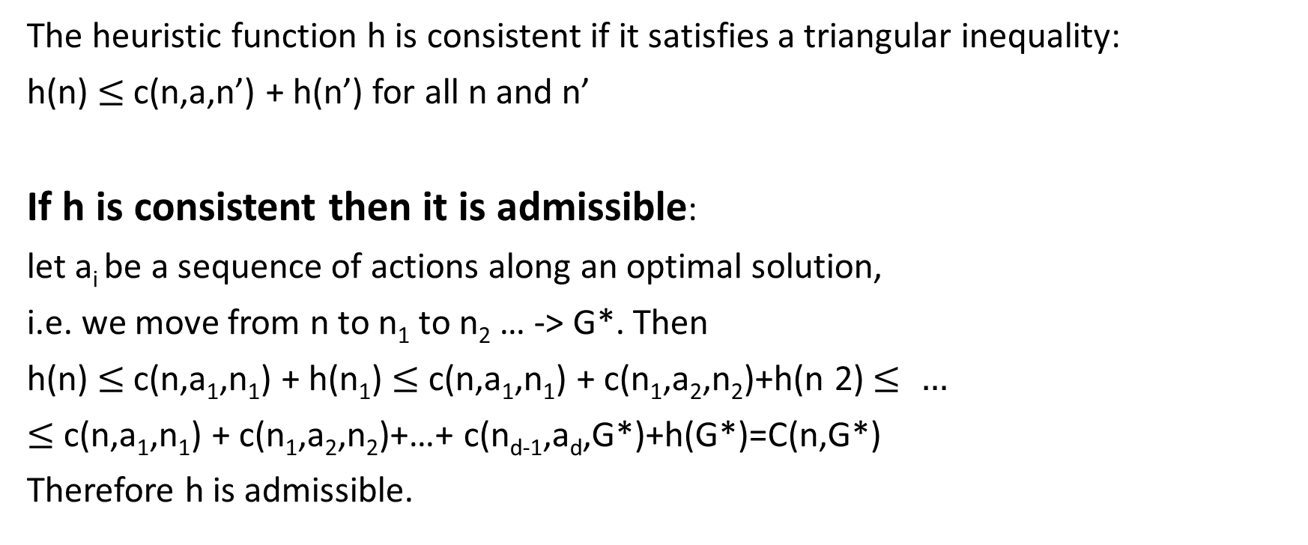
Consistent h
The heuristic function h is consistent if it satisfies a triangular inequality:
h(n) $≤$c(n,a,n’) + h(n’) for all n and n’
If h is consistent then it is admissible:
let a_{i} be a sequence of actions along an optimal solution,
i.e. we move from n to n₁ to n₂ … -> G*. Then
h(n) $≤$c(n,a₁,n₁) + h(n₁) $≤$ c(n,a₁,n₁) + c(n₁,a₂,n₂)+h(n 2) $≤ …$
$≤$ c(n,a₁,n₁) + c(n₁,a₂,n₂)+…+ c(n_{d-1},a_{d},G*)+h(G*)=C(n,G*)
Therefore h is admissible.

Slide 44
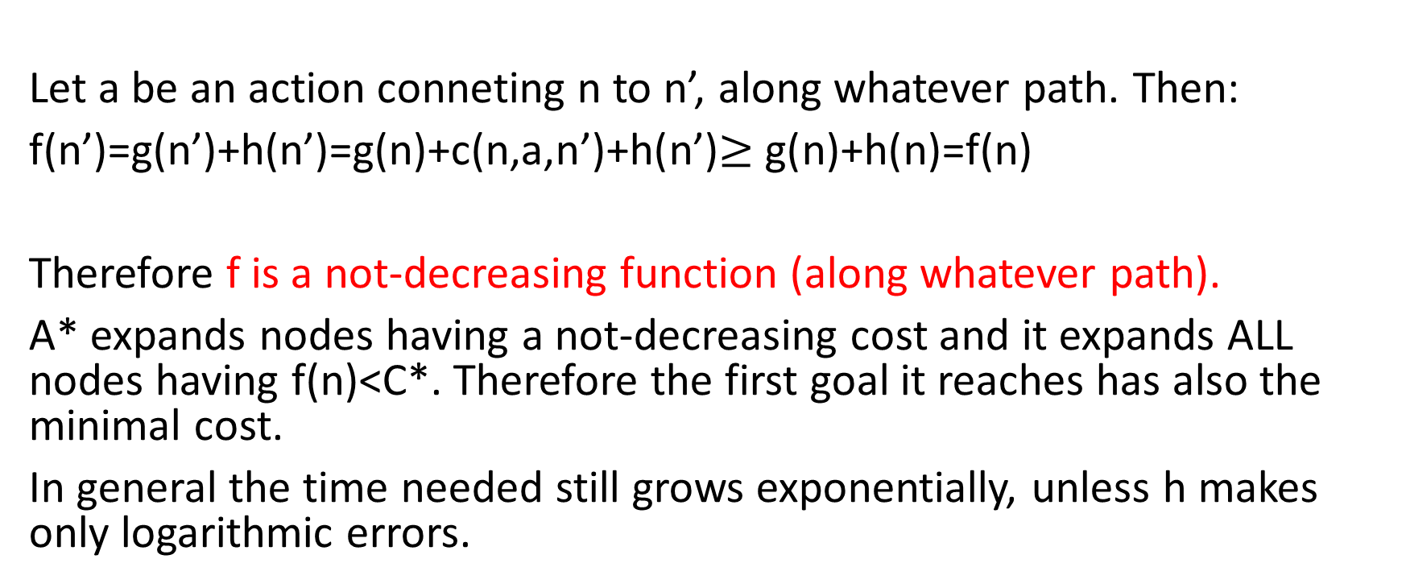
Again on optimality: if h is consistent then A* is optimal
Let a be an action conneting n to n’, along whatever path. Then:
f(n’)=g(n’)+h(n’)=g(n)+c(n,a,n’)+h(n’)$≥$g(n)+h(n)=f(n)
Therefore f is a not-decreasing function (along whatever path).
A* expands nodes having a not-decreasing cost and it expands ALL nodes having f(n)<C*. Therefore the first goal it reaches has also the minimal cost.
In general the time needed still grows exponentially, unless h makes only logarithmic errors.

Slide 46
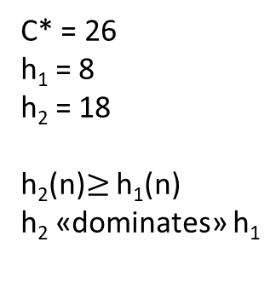
Inventing admissible heuristic functions
The cost of an optimal solution to a «relaxed» problem is an admissible heuristic function for the original problem.
8-puzzle:
Tile can jump: h₁ counts the number of missplaced tiles
Tile can move one step also over already occupied squares: h₂ counts the number of steps (Manhattan distance)
C* = 26
h₁ = 8
h₂ = 18
h₂(n)$≥$ h₁(n)
h₂ «dominates» h₁

Slide 47
Comparing Iterative Deepening search with A* Nodes generated N+1 = 1 + b*+ b*² + … + b*^{d}

Slide 48
Learning heuristic from experience
By solving many times a problem one can find correlations between certain characteristics of a state and the cost of the solution. E.g. a correlation between the number of misplaced tales and the cost.
Learning strategies, e.g. neural networks, can be used to extract this type of information and produce heuristic functions.
Random tests
Neural network extracting information
Use of the n.n. as an heuristic function

Slide 49
Local search
In many problems the path to the solution is irrelevant, for instance in problems of optimization.
If path is not needed:
Memory request are modest
It is possible to explore large spaces

Slide 50
Ridges

Slide 51
A local minimum: greedy search would get stuck
Here h counts the number of conflicting queens.
We want to find the configurations for which h=0.

Slide 52
Strategies for local search
Random restart hill-climbing: restarts from random generated initial states
Montecarlo techniques, simulated annealing: random walk and down-hill moves
Local beam search: generates all successors of k replica, then selects the best k successors from the complete list
Stochastic beam search: chooses randomly k successors from the complete list, with probability increasing with its value
Genetic algorithms: combines two parents and tries to mimic natural selection

Slide 53
Genetic algorithms
Non attacking
pairs of queens

Slide 54
Genetic algorithms
The mixing number, which is the number of parents that come together to form offspring.
The most common case is ρ = 2: two parents combine their “genes” (parts of their representation) to form offspring. When ρ = 1 we have stochastic beam search (which can be seen as asexual reproduction). It is possible to have ρ > 2, which occurs only rarely in nature but is easy enough to simulate on computers.
The selection process for selecting the individuals who will become the parents of the next generation:
one possibility is to select from all individuals with probability proportional to their fitness score. Another possibility is to randomly select n individuals (n > ρ), and then select the most fit ones as parents.
The recombination procedure.
One common approach (assuming ρ = 2), is to randomly select a crossover point to split each of the parent strings, and recombine the parts to form two children, one with the first part of parent 1 and the second part of parent 2; the other with the second part of parent 1 and the first part of parent 2.

Slide 55
The mutation rate, which determines how often offspring have random mutations to their representation. Once an offspring has been generated, every bit in its composition is flipped with probability equal to the mutation rate.
The makeup of the next generation.
This can be just the newly formed offspring, or it can include a few top-scoring parents from the previous generation (a practice called elitism, which guarantees that overall fitness will never decrease over time). The practice of culling, in which all individuals below a given threshold are discarded, can lead to a speedup.
Genetic algorithms are similar to stochastic beam search, but with the addition of the crossover operation. This is advantageous if there are blocks that perform useful functions. For example, it could be that putting the first three queens in positions 2, 4, and 6 (where they do not attack each other) constitutes a useful block that can be combined with other useful blocks that appear in other individuals to construct a solution. It can be shown mathematically that, if the blocks do not serve a purpose—for example if the positions of the genetic code are randomly permuted—then crossover conveys no advantage.
The theory of genetic algorithms explains how this works using the idea of a schema, which is a substring in which some of the positions can be left unspecified. For example, the schema 246***** describes all 8-queens states in which the first three queens are in positions 2, 4, and 6, respectively. Strings that match the schema (such as 24613578) are called instances of the schema. It can be shown that if the average fitness of the instances of a schema is above the mean, then the number of instances of the schema will grow over time.

Slide 56
geneticalgorithm
geneticalgorithm is a Python library distributed on Pypi for implementing standard and elitist genetic-algorithm (GA).
This package solves continuous, combinatorial and mixed optimization problems with continuous, discrete, and mixed variables. It provides an easy implementation of genetic-algorithm (GA) in Python.
Installation
Use the package manager pip to install geneticalgorithm in Python.
pip install geneticalgorithm
A simple example
Assume we want to find a set of X=(x1,x2,x3) that minimizes function f(X)=x1+x2+x3 where X can be any real number in [0,10]. This is a trivial problem and we already know that the answer is X=(0,0,0) where f(X)=0.
We define function f which we want to minimize and the boundaries of the decision variables; Then simply geneticalgorithm is called to solve the defined optimization problem as follows:
import numpy as np
from geneticalgorithm import geneticalgorithm as ga
def f(X):
return np.sum(X)
varbound=np.array([[0,10]]*3)
model=ga(function=f,dimension=3,variable_type='real',variable_boundaries=varbound)
model.run()

Slide 57
Optimization problems with constraints
In the previous example, the optimization problem was unconstrained. Now consider that we want to minimize f(X)=x1+x2+x3 where X is a set of real variables in [0,10]. Also we have an extra constraint so that sum of x1 and x2 is equal or greater than 2. The minimum of f(X) is 2. In such a case, a trick is to define penalty function. Hence we use the code below:
import numpy as np
from geneticalgorithm import geneticalgorithm as ga
def f(X):
pen=0
if X[0]+X[1]<2:
pen=500+1000*(2-X[0]-X[1])
return np.sum(X)+pen
varbound=np.array([[0,10]]*3)
model=ga(function=f,dimension=3,variable_type='real',variable_boundaries=varbound)
model.run()

Slide 58
The parameters of geneticalgorithm is defined as a dictionary:
algorithm_param =
{'max_num_iteration': None,\
'population_size':100,\
'mutation_probability':0.1,\
'elit_ratio': 0.01,\
'crossover_probability': 0.5,\
'parents_portion': 0.3,\
'crossover_type':'uniform’,\
'max_iteration_without_improv':None}
@ max_num_iteration: The termination criterion of geneticalgorithm. If this parameter's value is None the algorithm sets maximum number of iterations automatically as a function of the dimension, boundaries, and population size. The user may enter any number of iterations that they want. It is highly recommended that the user themselves determines the max_num_iterations and not to use None.
@ population_size: determines the number of trial solutions in each iteration. The default value is 100.
@ mutation_probability: determines the chance of each gene in each individual solution to be replaced by a random value. The default is 0.1 (i.e. 10 percent).
@ elit_ration: determines the number of elites in the population. The default value is 0.01 (i.e. 1 percent). For example when population size is 100 and elit_ratio is 0.01 then there is one elite in the population. If this parameter is set to be zero then geneticalgorithm implements a standard genetic algorithm instead of elitist GA.
@ crossover_probability: determines the chance of an existed solution to pass its genome (aka characteristics) to new trial solutions (aka offspring); the default value is 0.5 (i.e. 50 percent)
@ parents_portion: the portion of population filled by the members of the previous generation (aka parents); default is 0.3 (i.e. 30 percent of population)
@ crossover_type: there are three options including one_point; two_point, and uniform crossover functions; default is uniform crossover
@ max_iteration_without_improv: if the algorithms does not improve the objective function over the number of successive iterations determined by this parameter, then geneticalgorithm stops and report the best found solution before the max_num_iterations to be met. The default value is None.

